Slide 1
Chapter 2
2-6

Slide 2
String pattern matching
int String::Find(String pat) {
char *p = pat.str, *s = str ;
int i = 0 ; // i is starting point
if (*p && *s)
while ( i <= Length() – pat.Length() )
if ( *p++ == *s++ ) { // characters match, get next char in pat and s
if ( !*p ) return i ; // match found
}
else { // no match
i++ ; s= str+i ; p= pat.str ;
}
return -1 ;
} // end of Find

Slide 3
String Matching The Knuth-Morris-Pratt Algorithm
Definition: If p = p₀p₁…p_{n-1} is a pattern, then its failure function, f, is defined as
example
j 0 1 2 3 4 5 6 7 8 9
pat a b c a b c a c a b
f -1 -1 -1 0 1 2 3 -1 0 1

Slide 4
String Matching The Knuth-Morris-Pratt Algorithm (cont.)
From the definition of the failure function, we arrive at the following rule for pattern matching :
  If a partial match is found such that s_{i-j} … s_{i-1} = p₀p₁…p_{j-1} and s_{i} ≠ p_{j} then matching may be resumed by comparing s_{i} and p_{f(j–1)+1} if j ≠ 0. If j = 0, then we may continue by comparing s_{i+1} and p₀ .

Slide 5
Pattern - matching with a failure function
int String::FastFind(String pat) {
int PosP = 0, PosS=0 ;
int LengthP = pat.Length(), LengthS= Length();
while ( (PosP<LengthP) && (PosS<LengthS) ) {
if ( pat.str[PosP] == str[PosS] ) { // character match
PosP++; PosS++;
}
else
if ( PosP==0) PosS++ ;
else PosP=pat.f[PosP-1] + 1 ;
}
if (PosP < LengthP) return -1 ;
else return PosS – LengthP ;
}

Slide 6
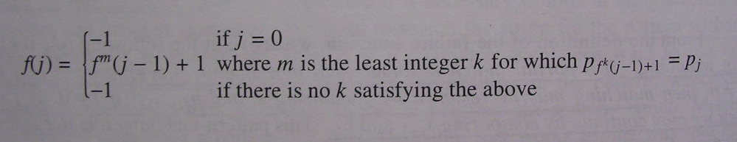
Computing the failure function
There is a fast way to compute the failure function :

Slide 7
Computing the failure function
void String::fail() {
int LengthP = Length() ;
f[0]=-1;
for ( int j=1; j<LengthP; j++) { // compute f [j]
int i= f [j-1];
while ( ( *(str+j)!=*(str+i+1) ) && (i>=0) )
i= f [i] ;
if ( *(str+j) == *(str+i+1) )
f [j]=i+1;
else
f [j]=-1;
}
} // end of fail

Slide 8
Fast Matching Example
Suppose exists a string s and a pattern pat = ‘abcabcacab’, let’s try to match pattern pat in string s.
j 0 1 2 3 4 5 6 7 8 9
pat a b c a b c a c a b
f -1 -1 -1 0 1 2 3 -1 0 1
s = ‘- a b c a ? ? . . . ?’
pat = ‘a b c a b c a c a b’
‘a b c a b c a c a b’
j = 4, p_{f(j-1)+1} = p₁
New start matching point

